Slide 1

Rwanda Bar Association Management Information System DEMO
July 05th, 2023

Slide 2

General Public
General public portal
RBA MIS is a web based application helps in daily activities of the Rwanda Bar Association secretariat. It creates a link between RBA, Advocates and the general public. The system can be accessible using internet on any device (Tablet, pc, phones, ….)
RBA MIS Enables the general public to search for an Advocates and have Information about his/her Practicing status, contact and address details.
The General public can search using the different options such as Names, Practicing area, District, … according to his purpose of search

Slide 3
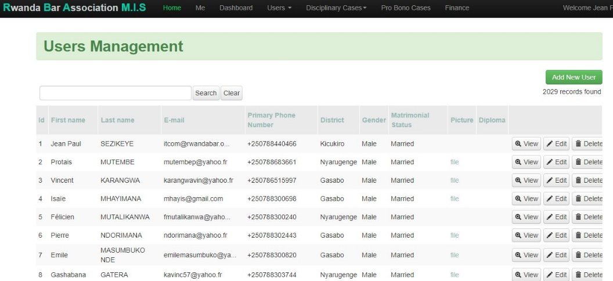
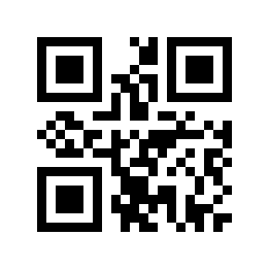
Advocates Management
User Management
The system has exhaustive database of Rwanda Bar Association members
The system can Assign practicing status within the RBA (Active, inactive, suspended, struck off)
The system can assign automatic Roll number depending on the roll status (Senior, interns) and QR code to each Roll number

Slide 4

Probono cases
Creating cases and assign to Advocate
RBA MIS has functionality that enables LA officers to create cases and assign a case to an advocate for further action to the courts. Advocates can report the progress of the case through RMA MIS
LA officers can Generate Goble reports on provided legal aid services

Slide 5
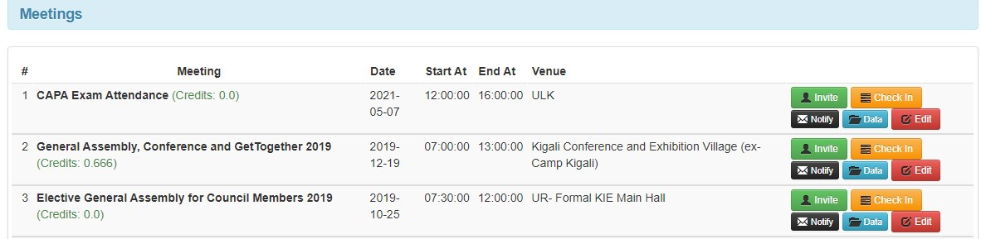
Meetings
RBA Meetings
The System allow to create meetings, Invite specific participants and create automatic attendance list by scanning the QR code on the Advocates’ professional cards
The system can send notifications about the meetings.
The system can create a detailed attendance report of the meetings

Slide 6
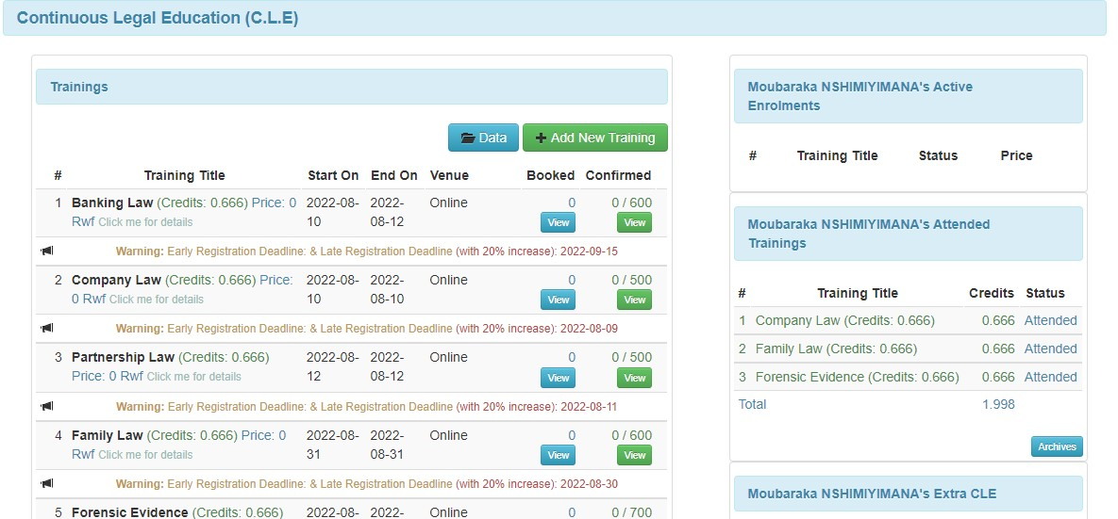
Continuous Legal Education (CLE)
CLE Management
The system has the Ability to create Trainings and invite focused group
Allow Advocates to book for trainings according to their availability
Ability to create attendance list and assign credits to the participants using attendance coupon
Avail Training materials
Allow to create Quarterly and annual CLE reports

Slide 7
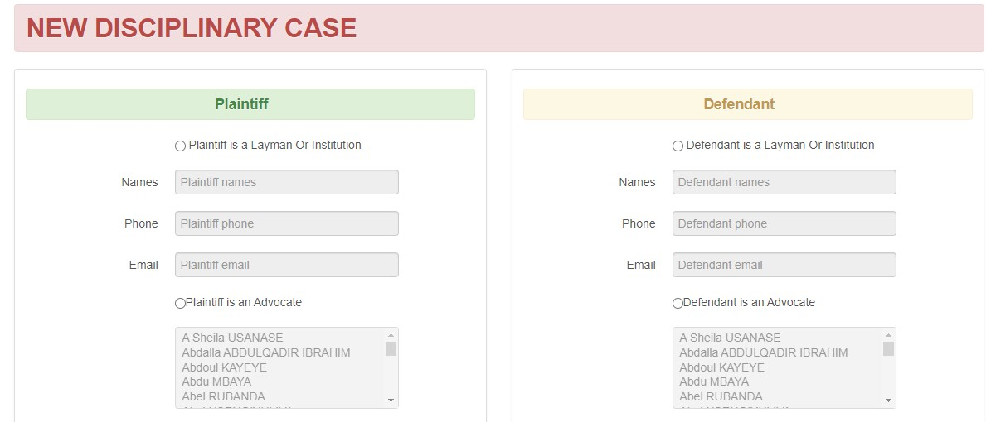
Disciplinary cases Management
Disciplinary
The system has the Ability to create, submit and access the disciplinary cases
The system can notify concerned parties on the progress of the submitted cases.
Concerned parties can access the president's decision or DC decision
The system can provide disciplinary cases report (Monthly, quarterly and yearly)

Slide 8
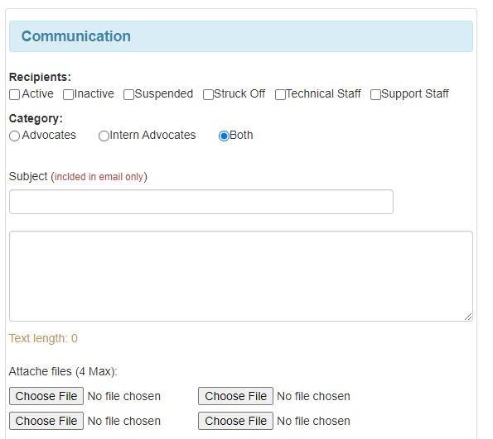
Communication
Emailing platform
The system can provide emailing platform to disseminate different Official communique to Advocates

Slide 9


